Slide 1
MGMT 6055 Project Scope & requirements
Lawrence Kinlin School of Business
Module 10

Slide 2

Learning Objectives
Six Sigma projects
Intro to Six Sigma
DMAIC Methodology

Slide 3
Six Sigma
A management philosophy
Features themes, techniques and tools for process improvement
Developed by Motorola in the mid-1980s
Involves setting high objectives, collecting data, analyzing results for the purpose of reducing defects/inefficiencies in products/services

Slide 4
Six Sigma
The term ‘Six Sigma’ represents standard deviation (amount of variation)
Used for measuring quality – in this case process, service or project quality
Includes DMAIC methodology (Define, Measure, Analyze, Improve and Control)
This is ultimately about improving customer satisfaction
Notes:
4

Slide 5
Six Sigma
The goal is to have zero defects (in a product or process)
Cost reduction (process costs)
Less waste
Better understanding of customer requirements
More reliable products/services
But … it is expensive to implement, requires commitment, and there’s a long ‘learning curve’ (coloured belts to signify different levels of training/certification)
Notes:
5

Slide 6
Why is This Management Philosophy Called Six Sigma?
Greek letter sigma is used in mathematics to represent standard deviation (variation)
If you can measure how many defects are in a process, you can figure out how to systematically eliminate them
Sigma Rating: the % of defect-free products in a process
99.99966% of all products are defect-free when the system has achieved a 6-sigma rating

Slide 7
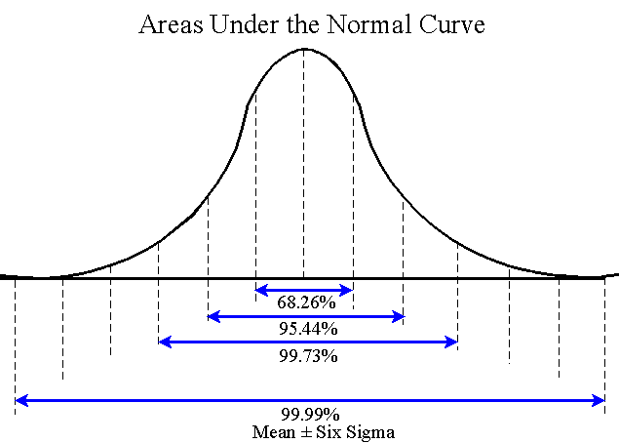
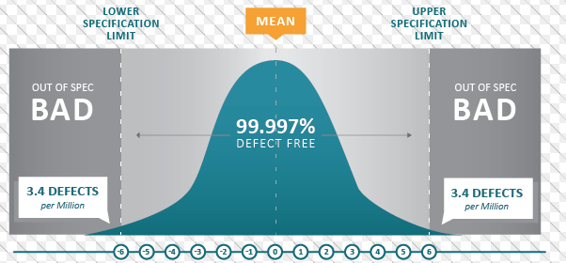
Why is This Management Philosophy Called Six Sigma?
The goal is to improve processes so that there are fewer defects that fall outside the range of acceptable specifications (i.e., to reduce/eliminate variation in the process).
(If you decide to take the PMP designation examination, you would be expected to memorize the percentages associated with each sigma…but not for our course!)
Notes:
Note about these diagrams: Technically, the diagrams are incorrect. Yes, a process is considered in control if all outputs fall within ± 6σ of the mean μ. However, the mean may shift up to 1.5 σ and the process is still deemed “in control”. Therefore, “out of control” outputs are actually >+ 4.5 σ, OR < – 4.5σ from the mean. According to the one-tailed Normal distribution, the ‘out of control’ elements are 3.4 ppm.
June 7, 2017 https://en.wikipedia.org/wiki/Six_Sigma has the best explanation.
Sources:
https://www.google.ca/search?q=six+sigma&source=lnms&tbm=isch&sa=X&ved=0CAcQ_AUoAWoVChMI2ZCPi_-ZyQIVyqseCh2f0gQz&biw=1680&bih=953#tbm=isch&q=six+sigma+chart&imgrc=ZuENS_1ryRxe3M%3A
https://www.google.ca/search?q=six+sigma&source=lnms&tbm=isch&sa=X&ved=0CAcQ_AUoAWoVChMI2ZCPi_-ZyQIVyqseCh2f0gQz&biw=1680&bih=953#tbm=isch&q=six+sigma+chart&imgrc=3wBGbUm2bcW8HM%3A

Slide 8

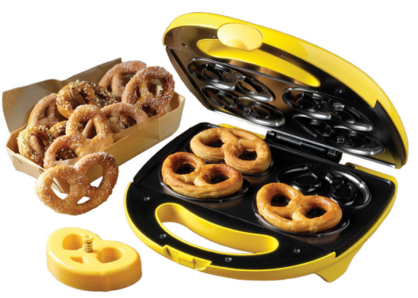
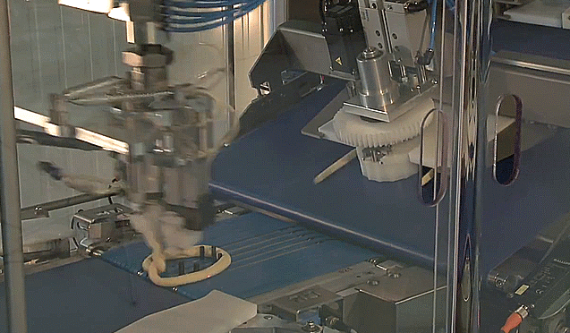
Process Variation: Pretzel example…
Handmade Pretzels: variation in sizes/shapes, inefficiencies/waste, lots of “duds” that get thrown out and not sold to customers (a 2-sigma process, or 2-sigma accuracy in the process)
Pretzels made with a Press: less variation in sizes/shapes, more efficient, fewer “duds” that get thrown out and not sold to customers (a 3-sigma process, or 3-sigma accuracy in the process)
Automated Pretzel Making: very little variation in sizes/shapes, very efficient, almost no “duds” that get thrown out (a 6-sigma process, or 6-sigma accuracy in the process)
Notes:
Source: https://www.google.ca/search?q=handmade+pretzels&tbm=isch&tbo=u&source=univ&sa=X&ved=0CDgQsARqFQoTCMzAyJWAmskCFUIcPgod15YO1g&biw=1680&bih=953#tbm=isch&q=pretzel+making+machine&imgrc=faZwC9mVXuCL2M%3A
https://www.google.ca/search?q=handmade+pretzels&tbm=isch&tbo=u&source=univ&sa=X&ved=0CDgQsARqFQoTCMzAyJWAmskCFUIcPgod15YO1g&biw=1680&bih=953#tbm=isch&q=pretzel+making+machine&imgrc=2hkxQ1BR2HhicM%3A

Slide 9
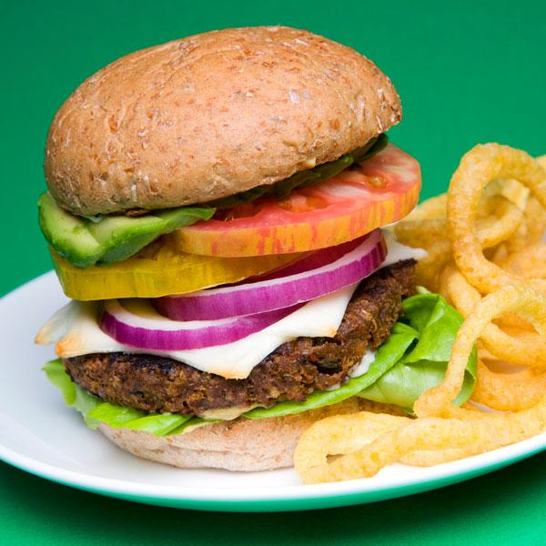
Another Example
You have just ordered the vegetarian burger at a fast-food restaurant…

Slide 10
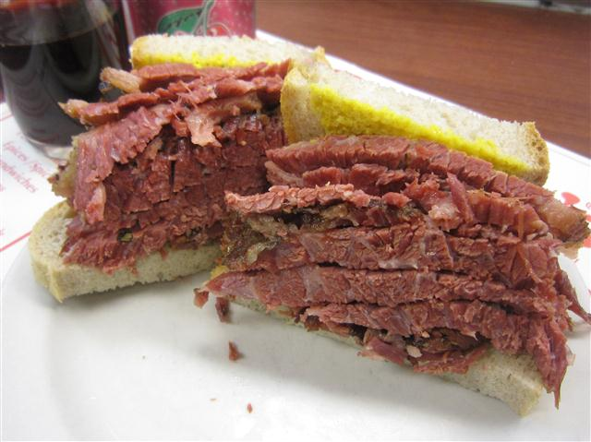
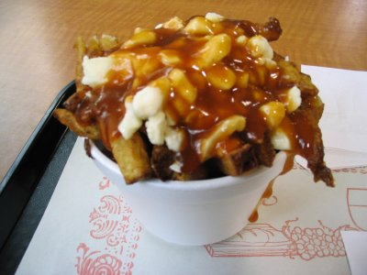
And this is what you got…???
With a side of…
Clearly, there are errors in this production process!

Slide 11
What are the implications of this mistake? How did this mistake happen?
Notes:
Ask the class

Slide 12

What are the Implications?
The customer doesn’t get what he/she wanted
Customer may not purchase from your organization again
Your reputation suffers
Customer may spread ‘negative word of mouth’, resulting in future lost business
The organization may have to give a refund ($) or may have to fix the order ($)

Slide 13

How Could This Have Happened?
For example…
The customer wasn’t clear in communicating the order
The order-taker didn’t understand the customer due to…
Language barriers
Employee wasn’t familiar with menu
Too much noise so couldn’t hear
The order-taker punched the incorrect buttons on the sales terminal
The kitchen didn’t receive the order correctly
The kitchen ran out of ingredients and made some substitutions
Etc.
A six-sigma project can be implemented to make process improvements!
Notes:
Ask the class

Slide 14
Six Sigma
Six Sigma is a problem-solving methodology
The goal is to have zero defects in a product or process (this is not realistically possible, but it is the objective)
This is a variation of project methodology, used for projects involving system performance improvement
Notes:
Ask the class

Slide 15
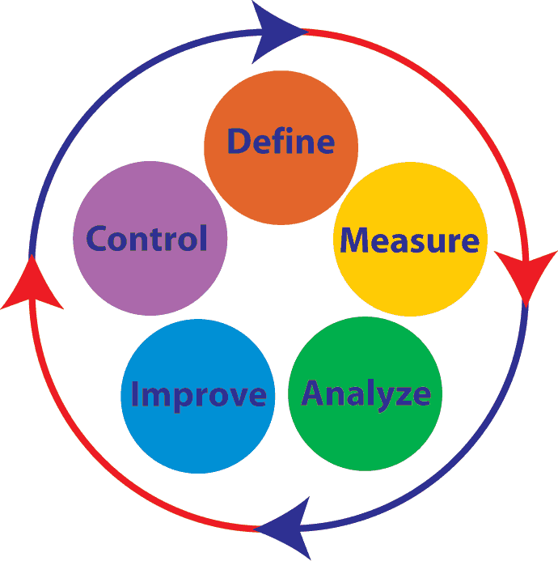
DMAIC Methodology
This is the principle methodology used in Six Sigma
Pronounced “duh – MAY – ick”
It is a cyclical methodology, representing continual improvement
Elements:
Define
Measure
Analyze
Improve
Control
This methodology is used when you have an existing process that you want to improve.

Slide 16
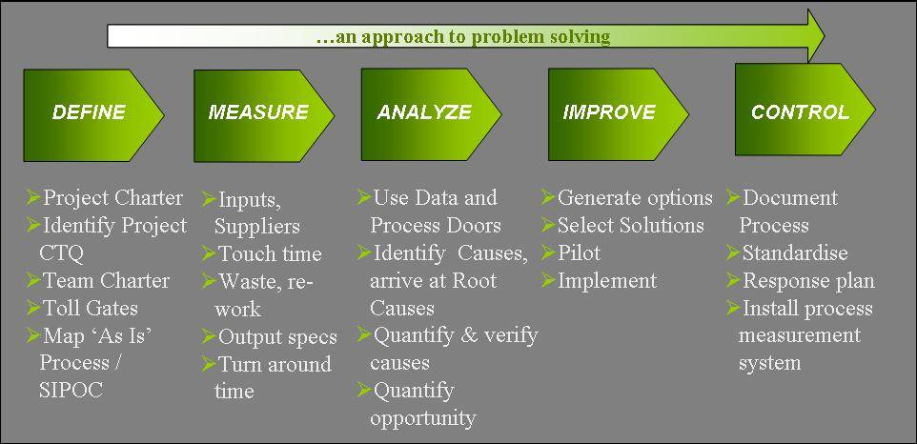
DMAIC Methodology
Important slide for Assignment 4!
See “Notes” for this slide for explanations (Notes View in PPT, which shows comments/notes below the PPT slide on your screen)
Notes:
Note: In your organization or industry, some of the items listed here under ‘define’, ‘measure’, ‘analyze’ may be placed in different stages of DMAIC. For example, according to the 2015 ASQ Six Sigma BOK, process mapping occurs in Measure phase and waste identification occurs in Analyse phase.
CTQ = Critical to quality = similar to acceptance criteria (what are the success criteria for this improvement project – eg performance requirements, specification limits)
Toll Gates = A SIPOC diagram is a tool used by a team to identify all relevant elements of a process improvement project before work begins.
Toll Gates = What are the “go/no-go” decision-stages in the Six Sigma project? (e.g., see What Are The 15 Tollgates of a Successful Six Sigma Project? (villanovau.com) ). [For this course, we can also define toll gates as they relate to the process being improved. For example, are there points in the process where the process progresses to a next major stage, where potential problems might terminate the process?]
SIPOC = Suppliers, Inputs, Process, outputs, Customers Rqmt’s (see following slides)
Touch time = Are there any parts of the process where there is idle time? We want to understand how much time in a process is spent where the product is being manipulated/created versus slack time. Too much slack time might imply process inefficiencies.
Turn around time = The entire cycle time for the process, from start to finish
Pilot = Rolling out implementation for a limited period of time, or to limited locations, to test the implementation of the solution (to make sure the solution is working).

Slide 17
DMAIC: Define
Define problem, goals, and scope
Determine customer needs
Establish team and resources
Includes creation of SIPOC tables and process maps
What’s the problem? What do we want? What is the desired outcome?
Notes:
Note: per the ASQ 2015 Six Sigma BOK, the SIPOC is created in Measure phase. Not Define. So check to determine the norms for your organization/industry to clarify the placement of each activity in each stage of the DMAIC process…

Slide 18
Define: SIPOC
Pronounced “SIGH-pock”
A tool for summarizing inputs and outputs of a process in table form
Identifies relevant elements of a process improvement project before work begins
Suppliers, inputs, process, outputs, customers

Slide 19
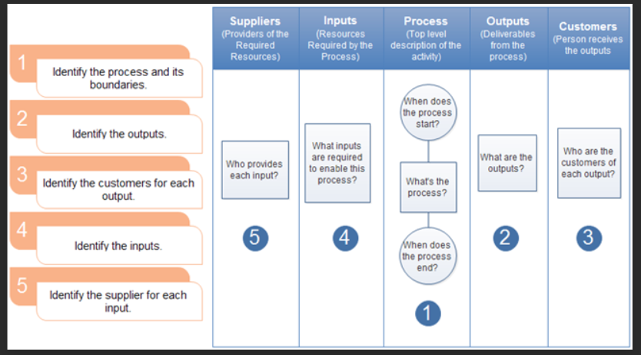
Define: SIPOC
FYI: If you want to learn more about the SIPOC diagram, watch this helpful video!
Notes:
https://www.edrawsoft.com/howto/sipoc-how.png

Slide 20
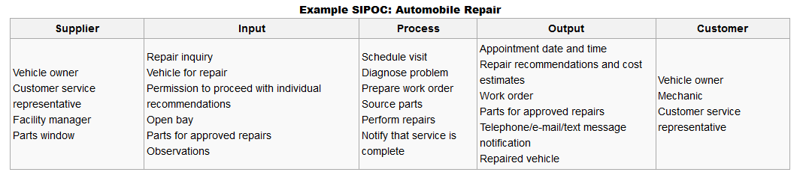
Another SIPOC Example
To build a SIPOC chart: Start by identifying the key steps in the Process, then identify the Outputs of the process, then identify the Customers who will receive the outputs, then identify the Inputs required for the process to function properly, then identify the Suppliers of the inputs.
Notes:
Source: http://en.wikipedia.org/wiki/SIPOC

Slide 21
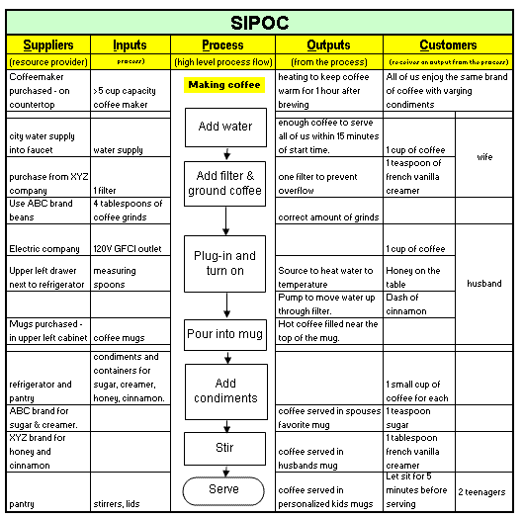
Another SIPOC Example
Notes:
Source: http://www.six-sigma-material.com/SIPOC.html

Slide 22
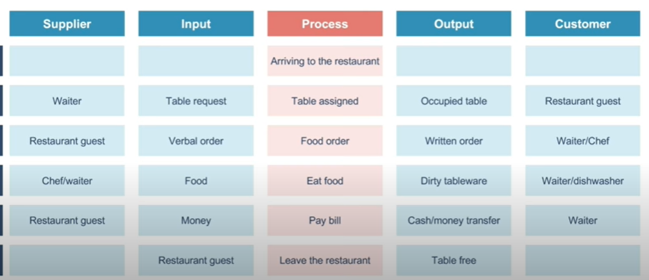
Another SIPOC Example
Notes:
SIPOC Diagram explained (with example) - YouTube

Slide 23
Define: Process Map
http://www.youtube.com/watch?v=xLWLcVrI_WE
FYI: You won’t be tested on this video for the final exam, but you can watch it to improve your understanding of process maps…
Notes:
Using the DMAIC Methodology map out this process

Slide 24
DMAIC: Measure
Create data collection plan
Document current process
Baseline current performance
Measure each step in the process with respect to time, success, quality, etc.
Think hard about this! How do we quantify or measure results in each stage of the process?

Slide 25
DMAIC: Analyze
Benchmarking
Perform data analysis
Identify problems and root causes
Understanding the cause-effect of problems/inefficiencies. If you change an input, how is the output affected?

Slide 26

Activity: Process Improvement at McDonalds
DEFINE:
Describe each step in the process for a customer to order and receive this product from McDonalds
MEASURE:
For each step in the process, identify ways that the effectiveness or success of the step can be measured (or assessed) – so that later in the DMAIC methodology, defects can be analyzed. In other words, how will you be able to identify whether or not a defect has occurred in this step?
ANALYZE:
Collect raw data and determine the performance of each step in the process. Analyze performance data – is it meeting the goals/expectations of the process?
Video: McDonalds Process Improvement
Notes:
Using the DMAIC Methodology map out this process

Slide 27
DMAIC: Improve
Identify solutions
Perform risk assessment
Identify contingency plans, if something goes wrong with the implementation
Perform solution pilot (How would you roll out the solution?)
Every process can be improved by controlling inputs to improve outputs

Slide 28
DMAIC: Control
Baseline pilot performance
Create procedures and documentation
Roll out solution to larger organization
When you have everything you need to get the outcome you want, how will you maintain/sustain that improvement?

Slide 29

Activity: Process Improvement at McDonalds
IMPROVE:
Identify ways to improve the performance results in each step of the process. Consider inputs and processes – how can we improve outputs? What are the risks associated with implementation? Implement changes incrementally (pilot in select locations or for a limited time, to see if the improvement is effective)
CONTROL:
Establish new performance baselines, incorporate new procedures in training documentation, implement the change on widespread basis
Notes:
Using the DMAIC Methodology map out this process

Slide 30
Readings/Videos for This MODULE
Read Kerzner: Section 20.7 (pages 722-723)*
Watch the following video clips:
Six Sigma in Plain English (5 min)
Introduction to Six Sigma (10 min)
Six Sigma at Caterpillar (12:00)
Read the following web articles*:
Six Sigma in Project Management – Definition, Cycle, Success Factors
Six Sigma & PMBOK, Coalition
* You may be tested on these concepts for the final exam! Make study notes from key concepts in Kerzner and these web articles.
Notes:
Group project

